Slide 1
Deep learning assisted framework for chest infection detection
By:
Mian Muhammad Umer Hassan Khan Qureshi
Supervised by:
Dr. Eva Navarro Lopez

Slide 2
Outline
_______________________________
Introduction
Objectives
Benefits
Requirement Specification
Methodology
Project Design
Implementation
Modern tools
Conclusion
Future Work
References
_______________________________

Slide 3
Introduction
A chest infection is an infection of the lungs. Some chest infections are mild and clear up on their own, but others can be severe and life threatening.
Pneumonia is an infection that inflames the air sacs in one or both lungs. The air sacs may fill with fluid or pus (purulent material), causing cough with phlegm or pus, fever, chills, and difficulty breathing. A variety of organisms, including bacteria, viruses and fungi, can cause pneumonia.
Coronaviruse (CoV) are a large family of viruses that cause illness ranging from the common cold to more severe diseases such as Middle East Respiratory Syndrome (MERS-CoV) and Severe Acute Respiratory Syndrome (SARS-CoV). A novel corona virus (nCoV) is a new strain that has not been previously identified in humans.

Slide 4
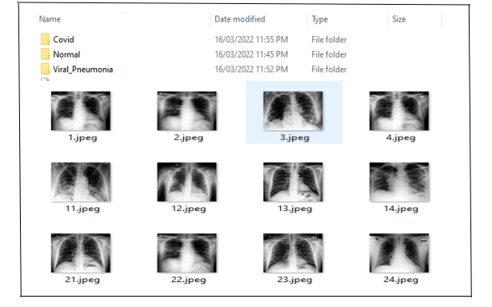
Dataset

Slide 5
Problem Statement
Conventional methods consume high computational power and show less accuracy.
Early diagnosis of Covid/Pneumonia is essential.
Expand the different types of visual characteristics such as shape, edges features etc to differentiate the chest infection type.
Limited research done in multi classification of chest infection.

Slide 6
Objectives
Develop well organized automatic chest infection classification system which has high accuracy, low complexity and performance.
Reduce the number of false detections.
System will automate the analysis and help physicians to do fewer tasks and achieve reliable results,

Slide 7
Benefits
This system provides a platform by the help of which physicians can classify the types of chest infection (Covid/pneumonia) in less time by going through automatic processes.
There is less chance of human error and saves time of physicians.
This is helpful in saving the life of patient at early stage.

Slide 8
Requirements Specifications (Functional Requirements)
Image upload.
Preprocessing(Image Resize,Image enhancement,Apply Gaussian filter)
Feature extraction
Classification.(CNN Model)
Classify chest infection class.
8

Slide 9
Requirements Specifications (Non-Functional Requirements)
Usability
Reliability
Performance
Flexibility
Maintainability
Accuracy
Robustness
Capacity
Efficiency
Human Factors
9

Slide 10
Methodology
We have analyzed all past techniques of machine learning and after reviewing their drawbacks we proposed “Convolution Neural Network” classifier that will yield maximum accuracy according to research.
Image input
Pre-Processing
Features Extraction
Classification
Result

Slide 11
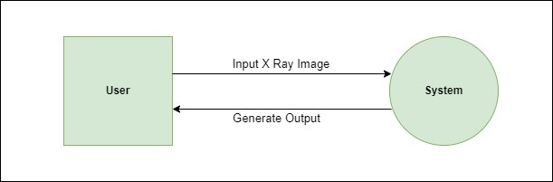
Project Design (Data Flow Diagram Level 0)

Slide 12
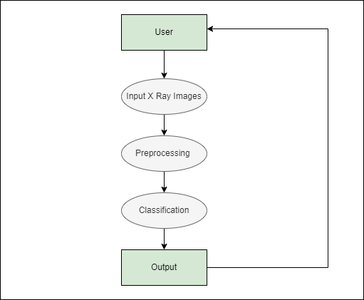
Project Design (Data Flow Diagram Level 1)

Slide 13
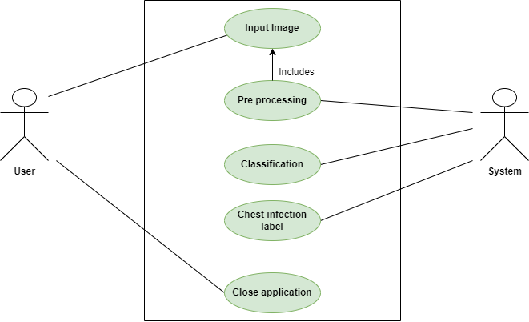
Project Design (Use Case Diagram)

Slide 14
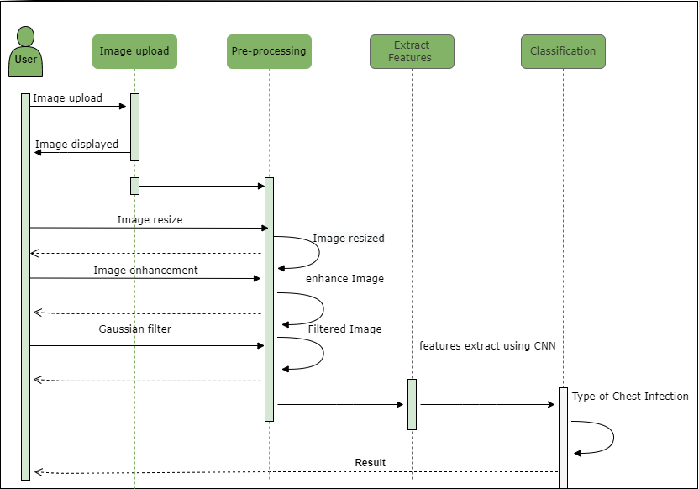
Project Design (Sequence Diagram)

Slide 15
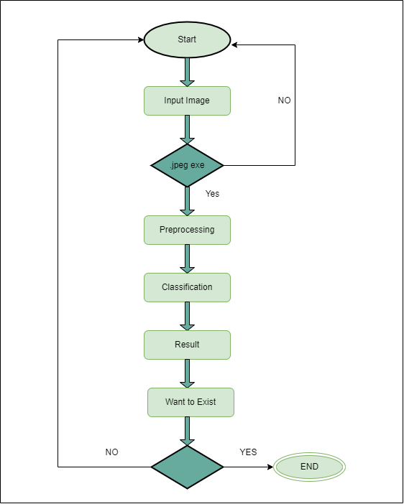
Project Design (Activity Diagram)

Slide 16
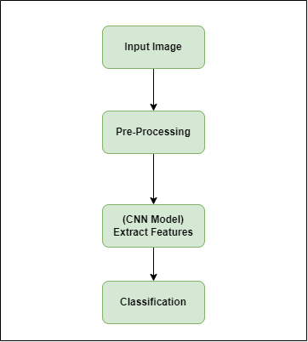
Implementation

Slide 17
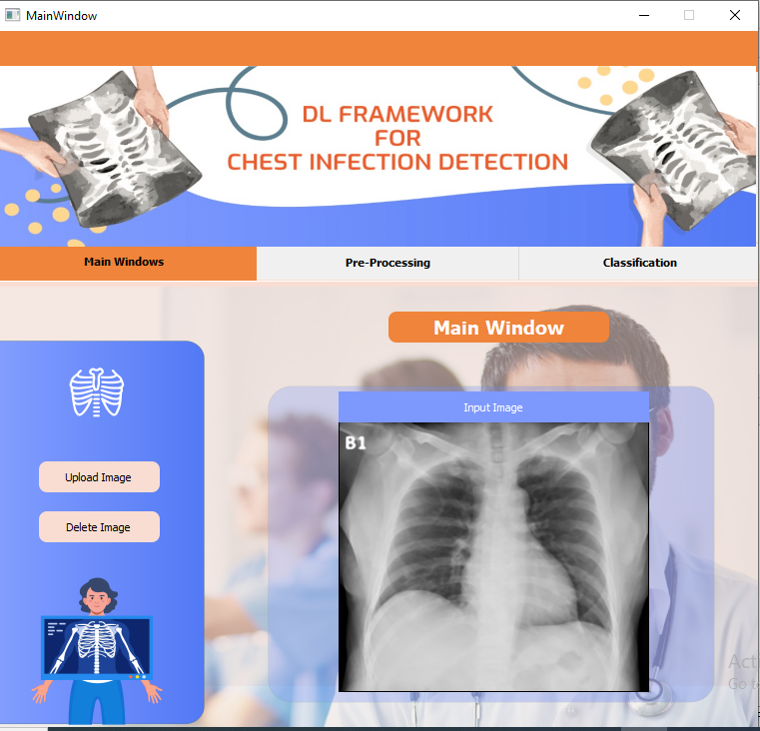
User Interface

Slide 18
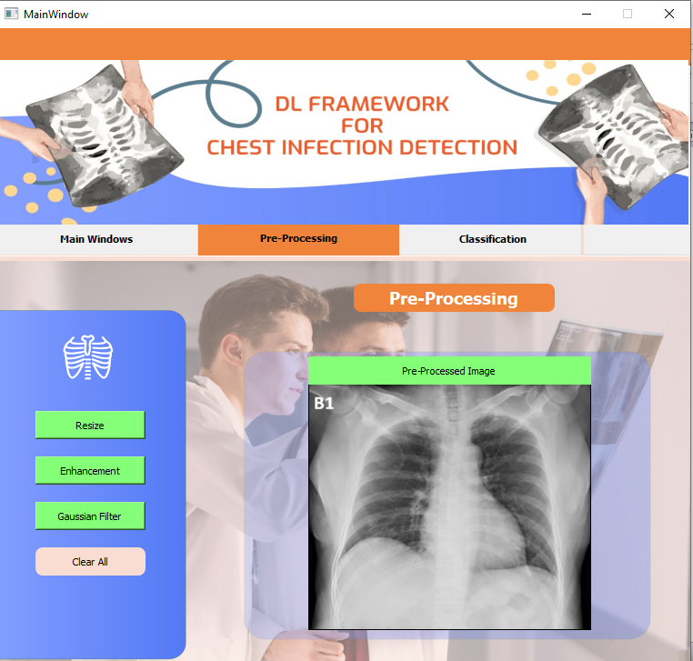
User Interface

Slide 19
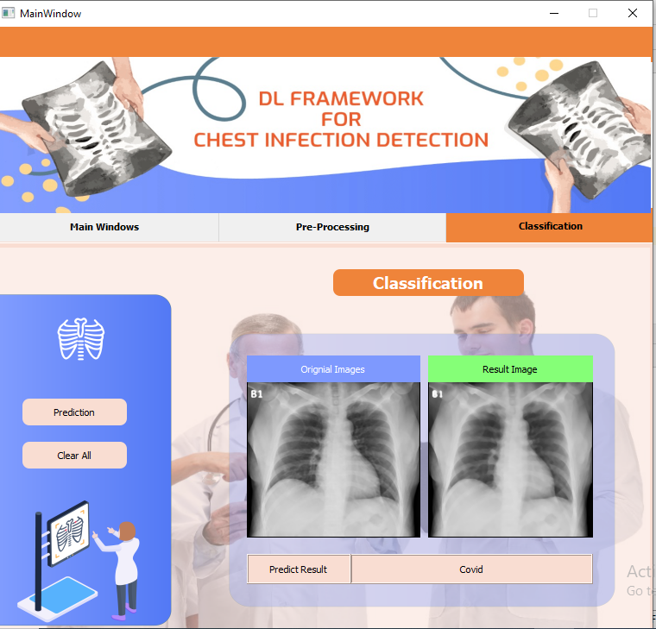
User Interface

Slide 20
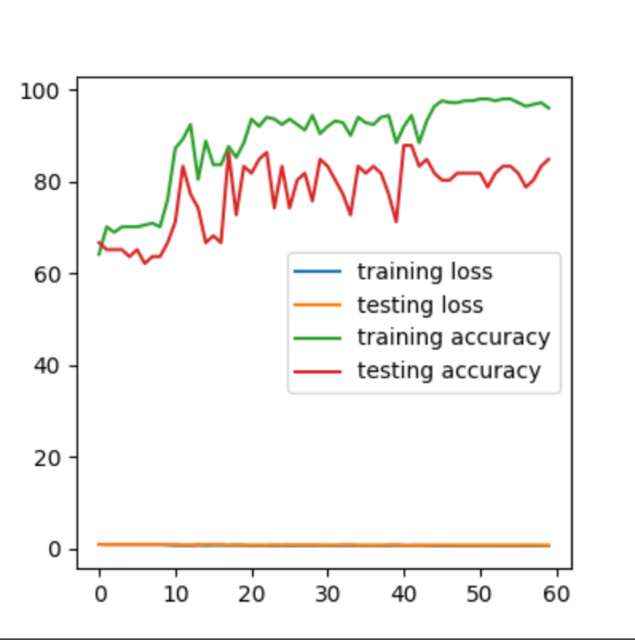
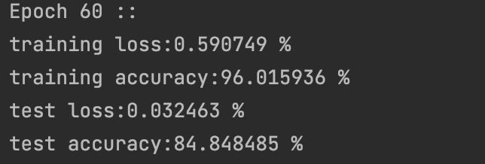
Training Result

Slide 21
Modern Tools
Development Tool:
Python–IDE
Anaconda : Libraries support
PyTorch : Python library module
PyQt Designer : Interface
PyCharm : Editor
MS Word :Documentation
MS PowerPoint : Slides
Programming Language:
Python

Slide 22
Conclusion
After study and implementation of deep learning in the field of chest infection diseases it is concluded that deep leaning while using Convolutional Neural Network (CNN) provide very competitive results.
For this current work 96% accuracy was achieved due to the usage of CNN and epoch.
This work uses a greater number of images to achieve better performance.

Slide 23
Future Work
In the future, CNN for chest disease would help medical stakeholders to avoid the conventional lab and tests.
We aim to extend the proposed model by including additional subtypes of pneumonia and different chest diseases.
The system's general accuracy could be enhanced. the overall classification accuracy can be increased with a larger data collection.

Slide 24
References
Dataset links:
https://www.kaggle.com/preetviradiya/covid19-radiography-dataset
https://www.kaggle.com/datasets/paultimothymooney/chest-xray-pneumonia
https://www.kaggle.com/datasets/imdevskp/corona-virus-report
Q. Li, X. Guan, P. Wu et al., “Early transmission dynamics in Wuhan, China, of novel coronavirus-infected pneumonia,” New England Journal of Medicine, vol. 382, no. 13, pp. 1199–1207, 2020.View at: Publisher Site | Google Scholar
L. Li, L. Qin, Z. Xu et al., “Using artificial intelligence to detect COVID-19 and community-acquired pneumonia based on pulmonary CT: evaluation of the diagnostic accuracy,” Radiology, vol. 296, no. 2, pp. E65–E71, 2020.View at: Publisher Site | Google Scholar
Pneumonia Home CDC, https://www.who.int/news-room/fact-sheets/detail/pneumonia.
World Health Organization, Standardization of Interpretation of Chest Radiographs for the Diagnosis of Pneumonia in Children/World Health Organization Pneumonia Vaccine Trial Investigators’ Group, WHO, Geneva, Switzerland, 2001.

